Slide 1
Cloud First Application Development
Lunchtime Learning
July 20, 2017
Bryan Hopkins, Lisa McBriar, Sam Donnelly

Slide 2
Cloud First AppDev Team
Not everyone is speaking, but this is everyone’s work
Tim Bouffard, Application Architect
Dave Curran, Sr. Business Systems Analyst
Sam Donnelly, Sr. Application Developer
Bryan Hopkins, Sr. IT Project Leader
Anome Mammes, Sr. Application Developer
Lisa McBriar, Sr. Business Systems Analyst
Frank Nguyen, Sr. Application Developer
Matt Schleindl, Application Architect

Slide 3
Today
Stack vs. Framework
Technology: Closer look at the cloud stack
How does each help?
Processes: Agile and Test Driven Development
Putting it in your hands
What’s on your mind?

Slide 4

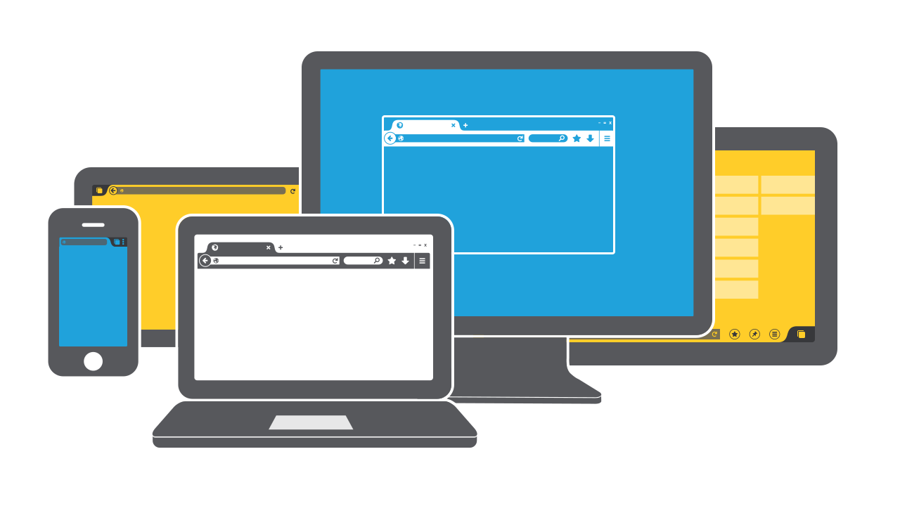
What goes into an app
A user interface What people see

Slide 5
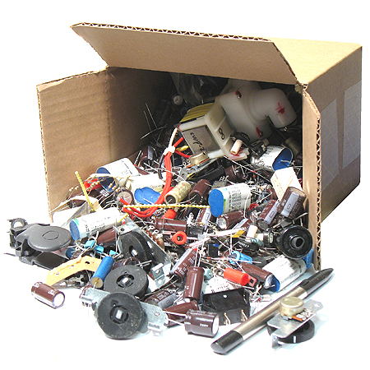
Behind the scenes
User interface
Business logic
Authentication and security
Persistence and data stores
Integration points
Testing
Source repository
Deployment pipeline
Platform
Process and SDLC

Slide 6
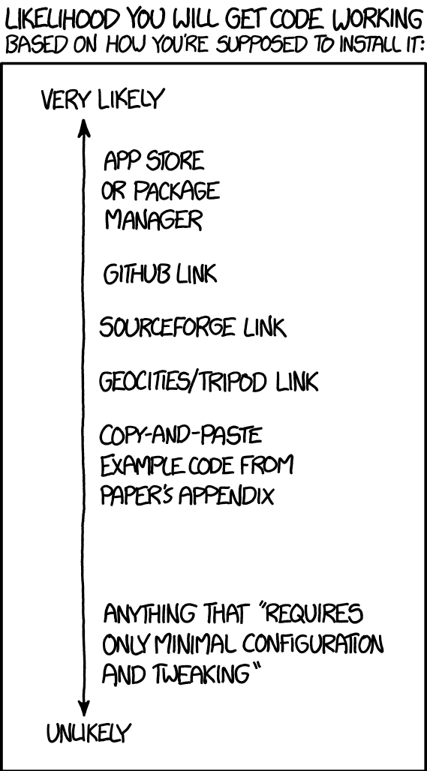
Cloud First Principles
Choose simplicity, speed, and iterative improvement over up-front completeness and strict controls.
Continuously iterate and re-evaluate decisions; nothing is beyond question.
Be mindful of increasing technical debt.
Choose automated solutions over manual ones, but respect the implications to manual process owners.
Use tools and technologies “off the shelf” in secure ways and as the provider intended.
Credit XKCD.com https://xkcd.com/1742/

Slide 7

So how does that translate?
Assembling a stack
Prioritize
Evaluate
Integrate
Automate
User interface
Business logic
Authentication and security
Persistence and data stores
Integration points
Testing
Source repository
Deployment pipeline
Platform
Process and SDLC
Notes:
Think of this laundry list as a technology stack
Each item is a framework to select and integrate, not something to build or customize.

Slide 8
Our Process
Blank Slate
Select a few areas of focus
Choose disposable placeholders
Evaluate / Pilot
Release to Production
Retrospective
Update architecture and processes

Slide 9
Where do we stand?

Slide 10



User Interface
 | For Developers… | For Analysts… | For Project Managers…
 | Full framework Thousands of components Readily available examples Data binding | Responsive by default Accessible components Cleaner, simple UIs UX vision more achievable | Open source From Google and Twitter Easy to find resources
 | In-browser debugging Angular-aware code completion Variable completion with typing with JSDoc |  | Inexpensive Contractors already know it
JetBrains Webstorm

Slide 11



Business Logic
 | For Developers… | For Analysts… | For Project Managers…
 | Full framework Thousands of packages Readily available examples Simple and powerful: few lines of code | Self documenting APIs Automatically generated test interfaces | Open source Tremendous campus presence Very easy to learn Easy to find resources
 | Django-aware code completion Great Django Testing integration |  | Inexpensive with a free tier
JetBrains PyCharm
Notes:
Pip!
By using Django you’re being a good university citizen, and can offer and receive help from a vibrant community

Slide 12
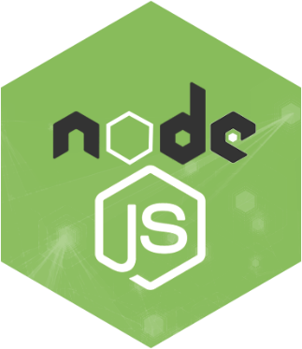
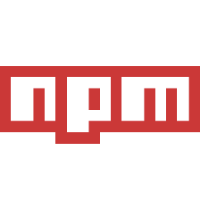
Authentication and Security
 | For Developers… | For Analysts… | For Project Managers…
 | Thousands of packages Readily available examples Incredible I/O performance Full stack | No effort PennKey login with Shibboleth | Open source Easy to find resources
 | Framework-aware code complete Fullstack debugging with AngularJS |  | Inexpensive with a free tier
JetBrains Webstorm
Notes:
Angular Fullstck – remind of demo from December
Automated patching of packages, with tests

Slide 13
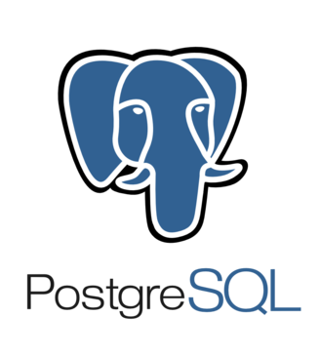
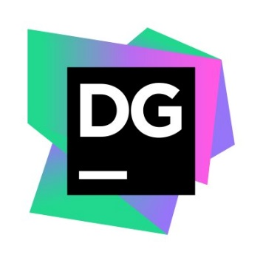
Data Store
 | For Developers… | For Analysts… | For Project Managers…
 | Oracle-like features That actually work! Highly performant Relational AND NoSQL | Drop-in replacement for Oracle Works great with Talend DB of choice for warehousing | Open source, ethical, and Free Strong local presence
 | Works with every RDBMS Powerful autocompletion | Very easy to use Don’t need to know SQL | Inexpensive
JetBrains DataGrip
Notes:
As with Django, you will have a good deal of local community support with Postgres.

Slide 14


Integration
 | For Developers… | For Analysts… | For Project Managers…
 | Fully supported SDK in every language Easy to follow examples Framework and platform agnostic Built in DDoS protection | Powerful and flexible security models API Keys and Usage plans Configurable “stages” | Incredibly cheap Fully managed Serverless Taggable for cost transparency Service orientation
 | Fully supported SDK in every language Failure tolerant Limitless scalability | Works with Mule | Inexpensive Taggable for cost transparency
Amazon SQS
Notes:
Flexible security models set us up for success no matter the future of IAM at Penn.
Also lets us easily grow in to the mobile app space.
SQS is the oldest AWS service. Highly reliable and well understood.

Slide 15

Closer Look: Microservices and SOA
Looser Coupling, More Flexible/Portable, More Complex Outer Architecture
No longer self-contained
Think service areas
DAR
Finance
Student systems
HR
Research
Composed of small pieces
Reusable
Built that way
Deployed that way
Monolithic App
Coarse-Grained Services
Microservices
WAR/EAR
Service Domain
Service Domain
Service Domain
Service A
Service B
Service C
Service D
Service E
App Server
App Server
Runtime
Runtime
Runtime
Runtime
Runtime
Runtime
Data Store
Data Store
Data Store
Data Store
Data Store
Data Store
Data Store
Data Store
Tighter Coupling, Less Flexible/Portable, Less Complex Outer Architecture
Notes:
A little sidebar about service orientation.
We’ve traditionally been focused on the left hand side. Trying to drift right.
Think service areas and not apps.
Architects really have a big role.

Slide 16




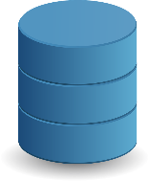



Closer Look: Microservices and SOA
No longer self-contained
Think service areas
DAR
Finance
Student systems
HR
Research
Composed of small pieces
Reusable
Built that way
Deployed that way
DAR Apps
Donate
Pledge
Volunteer
ATLAS Collection
DAR Services

Slide 17
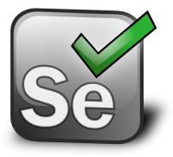



Testing
 | For Developers… | For Analysts… | For Project Managers…
 | Confidence in the spec | Easy to create and understand Fully automated regression tests | Bugs caught early take 10x less time
 | Built for AngularJS Easy stubbing and mocking with Sinon
 | Straightforward Like Junit Easy to test WebServices: no setup
KarmaJS
Notes:
3 types
End to End – Tests everything by hitting the deployed app
UI – Tests logic in the browser
Service – Tests business logic in your back end

Slide 18

Source Repository
 | For Developers… | For Analysts… | For Project Managers…
 | Offline work Easy branches and merging Webhooks for CI/CD integration | Create documentation developers actually use Intuitive web interface to browse files | Open source Universal adoption (git)
Gitlab Cloud

Slide 19

Deployment Pipeline
 | For Developers… | For Analysts… | For Project Managers…
 | Automate with Python Developers’ Swiss Army knife | More frequent deployment Automated tests run on each build Slack Integration
Jenkins
Notes:
Lets you automate all your checklists with each build.
No need for stress.
No need for excel.

Slide 20

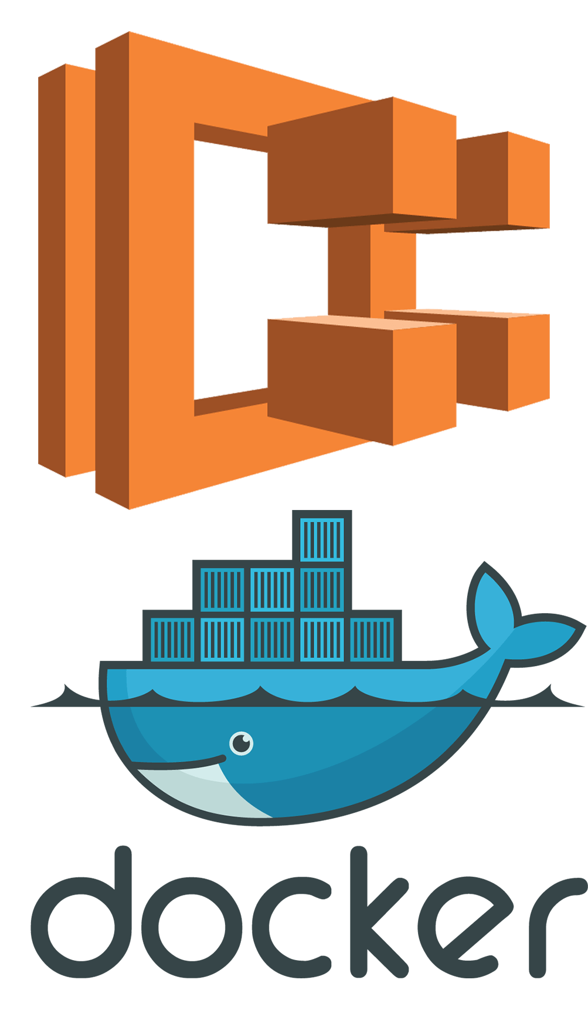
Platform
 | For Developers… | For Analysts… | For Project Managers…
 | Serverless Only worry about code Provisioned as code Isolated microservices Easy DRF integration with Zappa |  | Incredibly cheap Nothing to patch Massively scalable Taggable for cost transparency
 | Can run any docker image Service isolation Blue-green deployments |  | Can be sized and scaled to order Taggable for cost transparency
Amazon Lambda
Notes:
ECS and Docker – why not always go serverless?
Sometimes you need processes that run longer than 30-90s, like if you’re keeping websockets open with the browser.
Physical, virtual, OS, container, apache, tomcat… none of it. Just your code.

Slide 21

Platform
 | For Developers… | For Analysts… | For Project Managers…
 | Fully Managed Service Provisioned as code | Access like any other database | Fully managed Nothing to patch Scalable Taggable for cost transparency

Slide 22

Closer Look: Infrastructure as Code
Everything about your app is just code
Creating it defines and documents it
No patching. Delete and re-create.
No waiting! No manual action! Right the first time!
Notes:
So what do I mean when I keep saying “provisioned as code?”
You write scripts and JSON that create and define your whole platform and security model.
Documented and up-to-date, no ifs ands or buts.

Slide 23



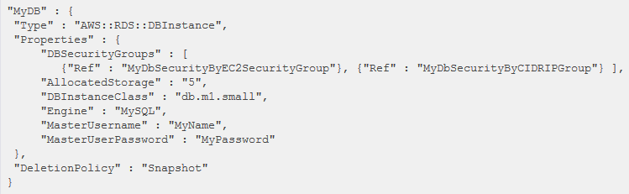
Closer Look: Infrastructure as Code

Slide 24
How does the tech fit together?

Slide 25
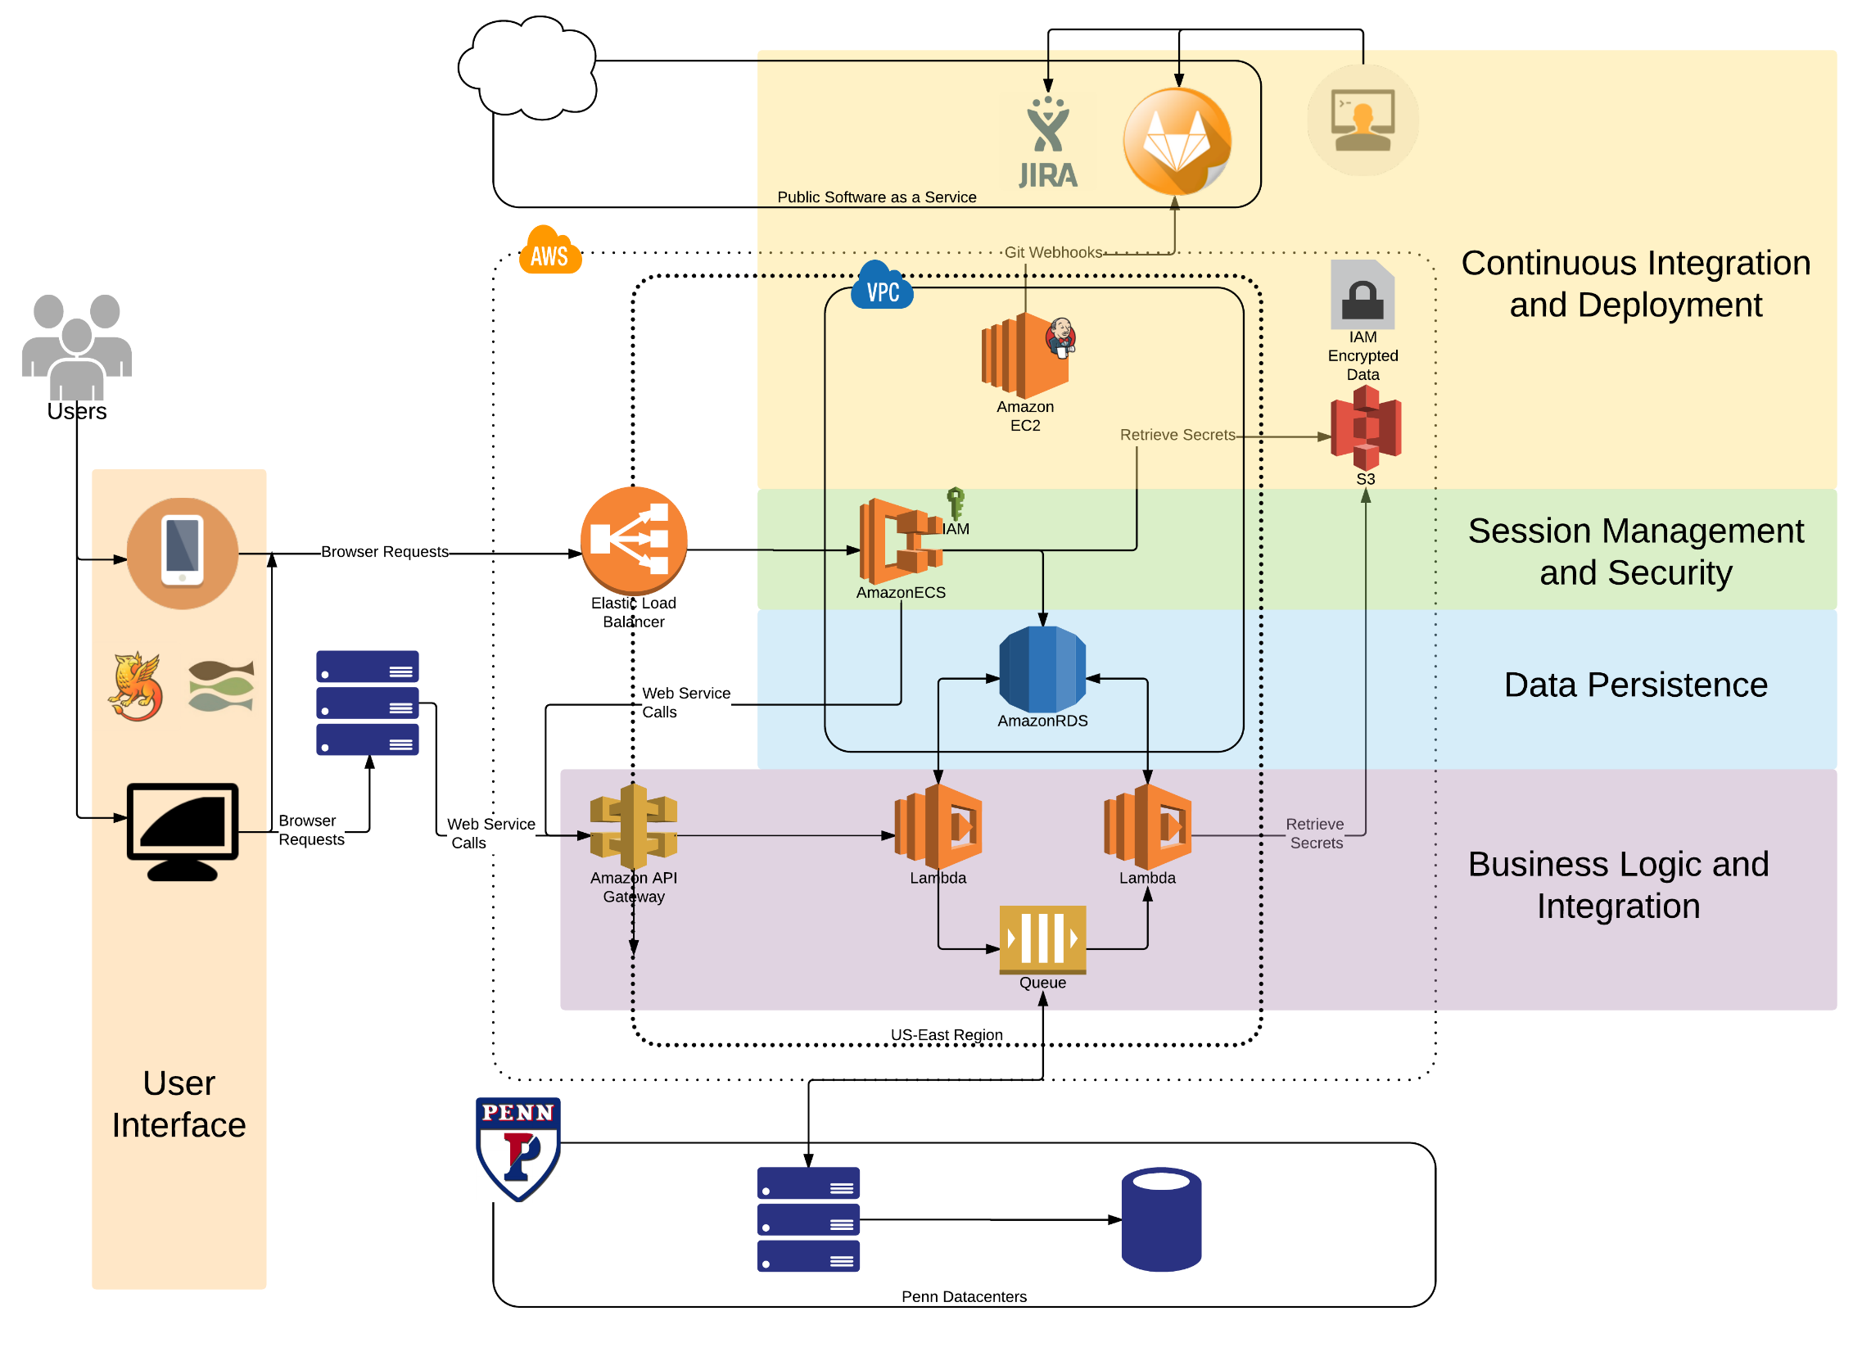

Slide 26
What about process?

Slide 27

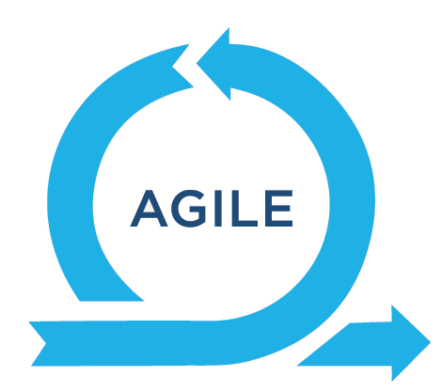
Process and SDLC
 | For Developers… | For Analysts… | For Project Managers…
 | Familiar tool Easy to use Highly collaborative | Plugin store Dependency tracking Drag and drop prioritization | Transparency Reports and progress-at-a-glance Collaborate externally
 | Focus on only a few details at a time Frequent feedback and adjustment | Focus is on “Yes” Rely on domain knowledge and organization No document writing | Speed and time-to-value Responsive to changes in priorities
Notes:
Don’t really need to sell this.
Groups like Melina’s team are already off and running showing the power of agile.

Slide 28
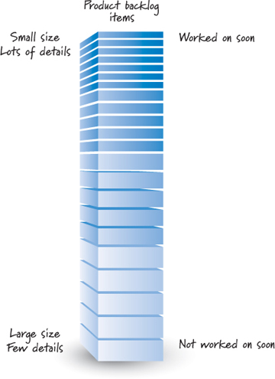
Closer Look: Cloud First Agile
Terminology
Backlog Sorted list of everything the clients want. Things at the top are better defined than things at the bottom.
Sprint Period of time where the team focuses on implementing the clients’ top priorities.
User story The basic unit of work capturing a feature or requirement from the end user’s perspective.
Epic A collection of User Stories that together define a significant feature or business process

Slide 29

Closer Look: Cloud First Agile
Prioritize and Define
Pick top 1-2 stories
Feature files
Build and Iterate
Technical subtasks
Test and Deploy
E2E Tests
Able to launch?
Create backlog
Create VERY high level story list
Screens
MVP?
Unit tests
Playbook
Daily Standup
Notes:
Emphasize importance of architects –
Take the stories and break them up into small units of technical work
Figure out how all the pieces fit together and how to manage the technical side of change

Slide 30
Closer Look: Cloud First Agile
Backlog drag and drop example
https://penn-isc-es.atlassian.net/secure/RapidBoard.jspa?projectKey=APND&rapidView=21&view=planning

Slide 31
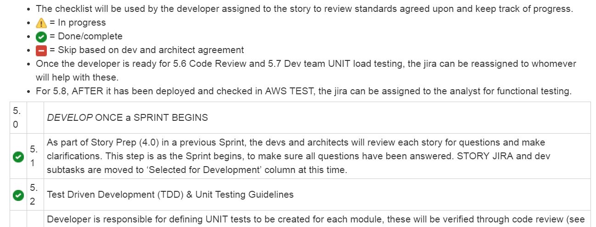
Closer Look: Cloud First Agile
User Story Playbook
Feature File
Screen Mockups
Architecture
Swagger
Diagram
Review with partners
Unit Tests
E2E Tests
Code Review
Accessibility Testing

Slide 32
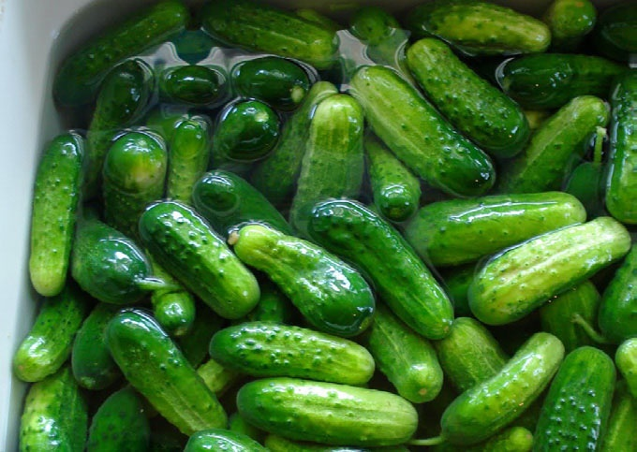
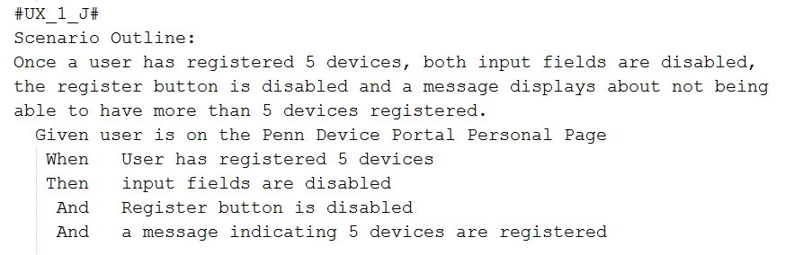
Closer Look: Cloud First Agile
Feature Files
Easy to read
Used to create Selenium tests
Notes:
Dave and Frank have really excelled in a very short amount of time at churning these out, getting agreement across stakeholders and turning them into tests.

Slide 33
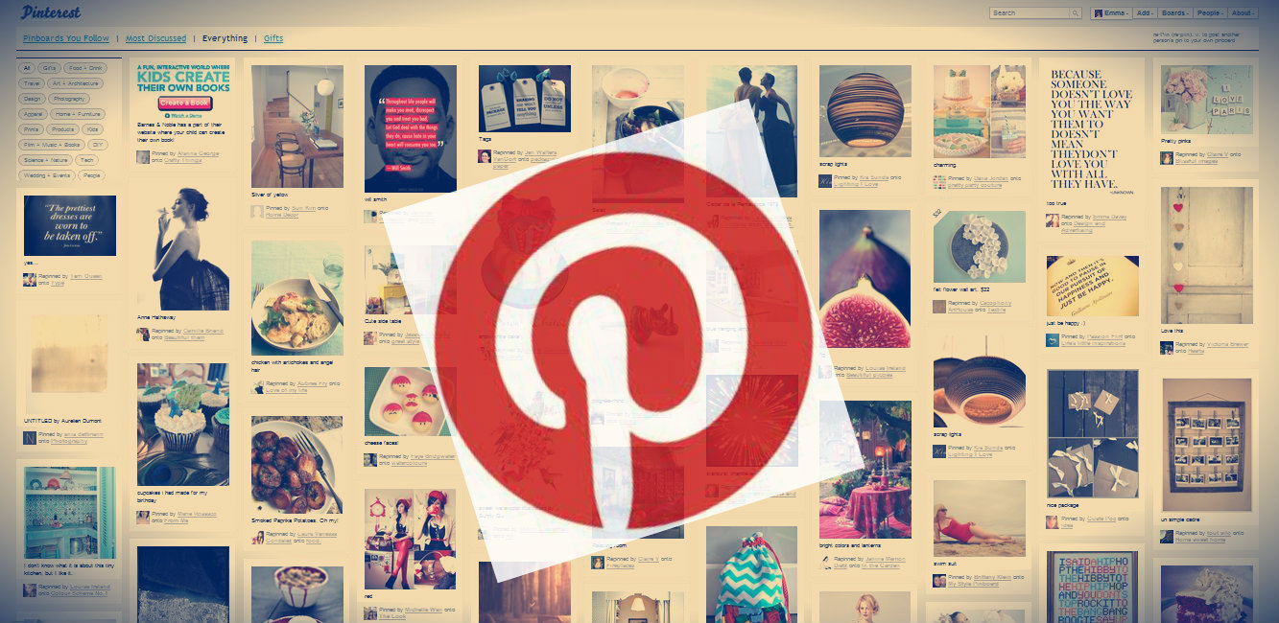
Boards!

Slide 34
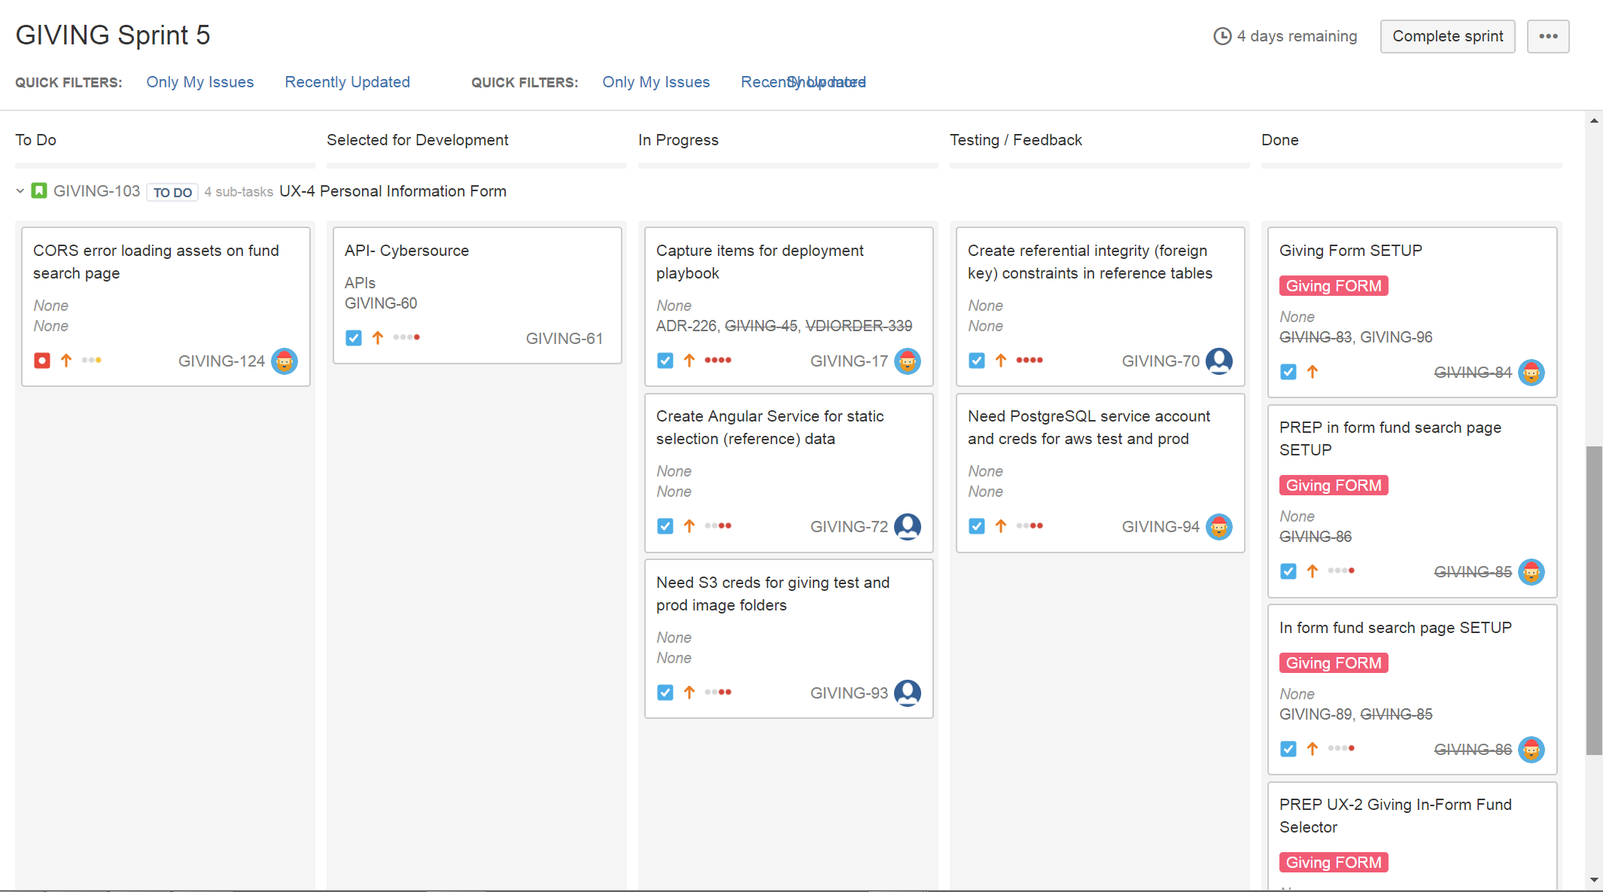
Boards: Example

Slide 35
Boards
Two Modes
Scrum Board: Active development in sprints
Kanban Board: Expediting support work
The only real difference is timeframe
Transparency
Team members see what each other are up to
Stakeholders can see what our priorities are – and give input
Support the standup meeting and client meetings
Notes:
With that, I’ll turn things over to Lisa to talk about the most exciting part of how she manages stories and boards: user experience

Slide 36
UX Design: My Journey

Slide 37
UX Design
What is UX Design?
“The process of enhancing user satisfaction by improving the usability, accessibility, and pleasure provided in the interaction between the user and the product.” --Wikipedia
https://uxmag.com/articles/explaining-ux-design-to-your-team

Slide 38

UX Design
Why is UX Design important?
Drives client and team conversations about USABILITY; most importantly, accessibility and responsiveness
Enables early design of UI components meeting Web Compliance Accessibility Guidelines (WCAG) 2.0 Level AA

Slide 39
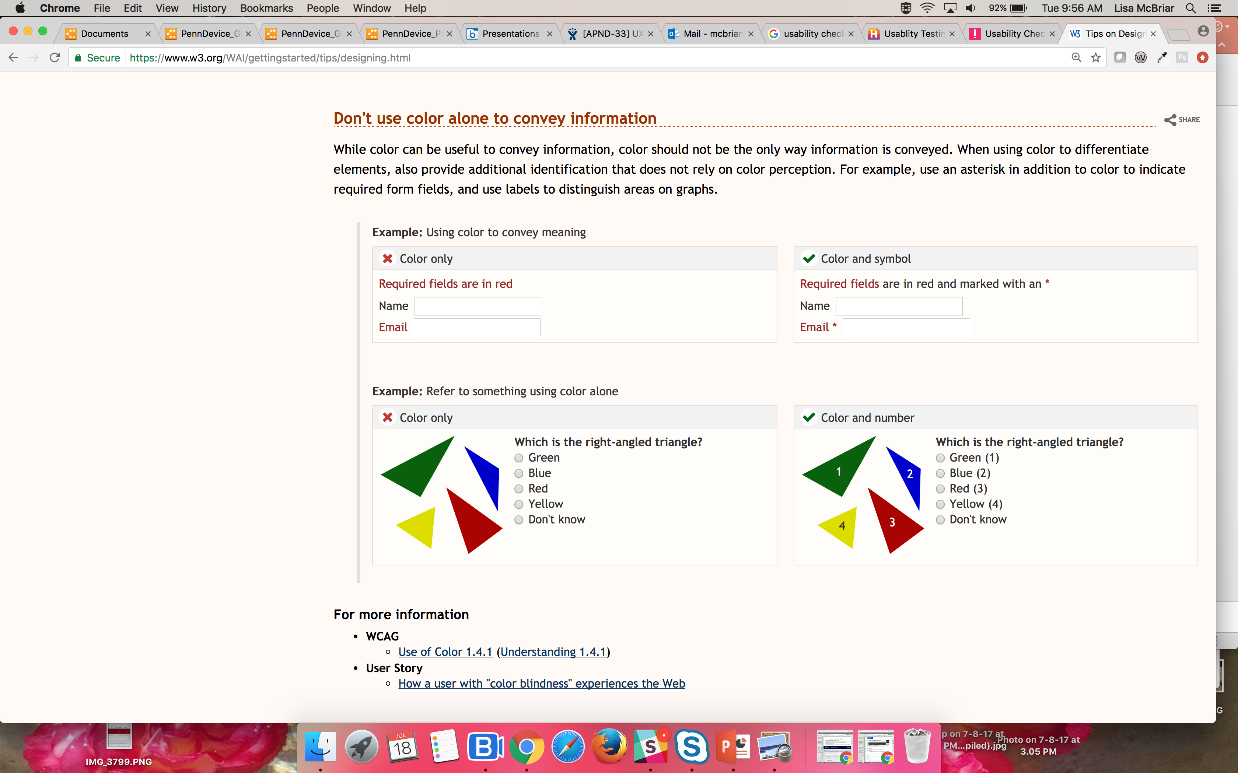
Accessibility design principle example
https://www.w3.org/WAI/gettingstarted/tips/designing.html

Slide 40
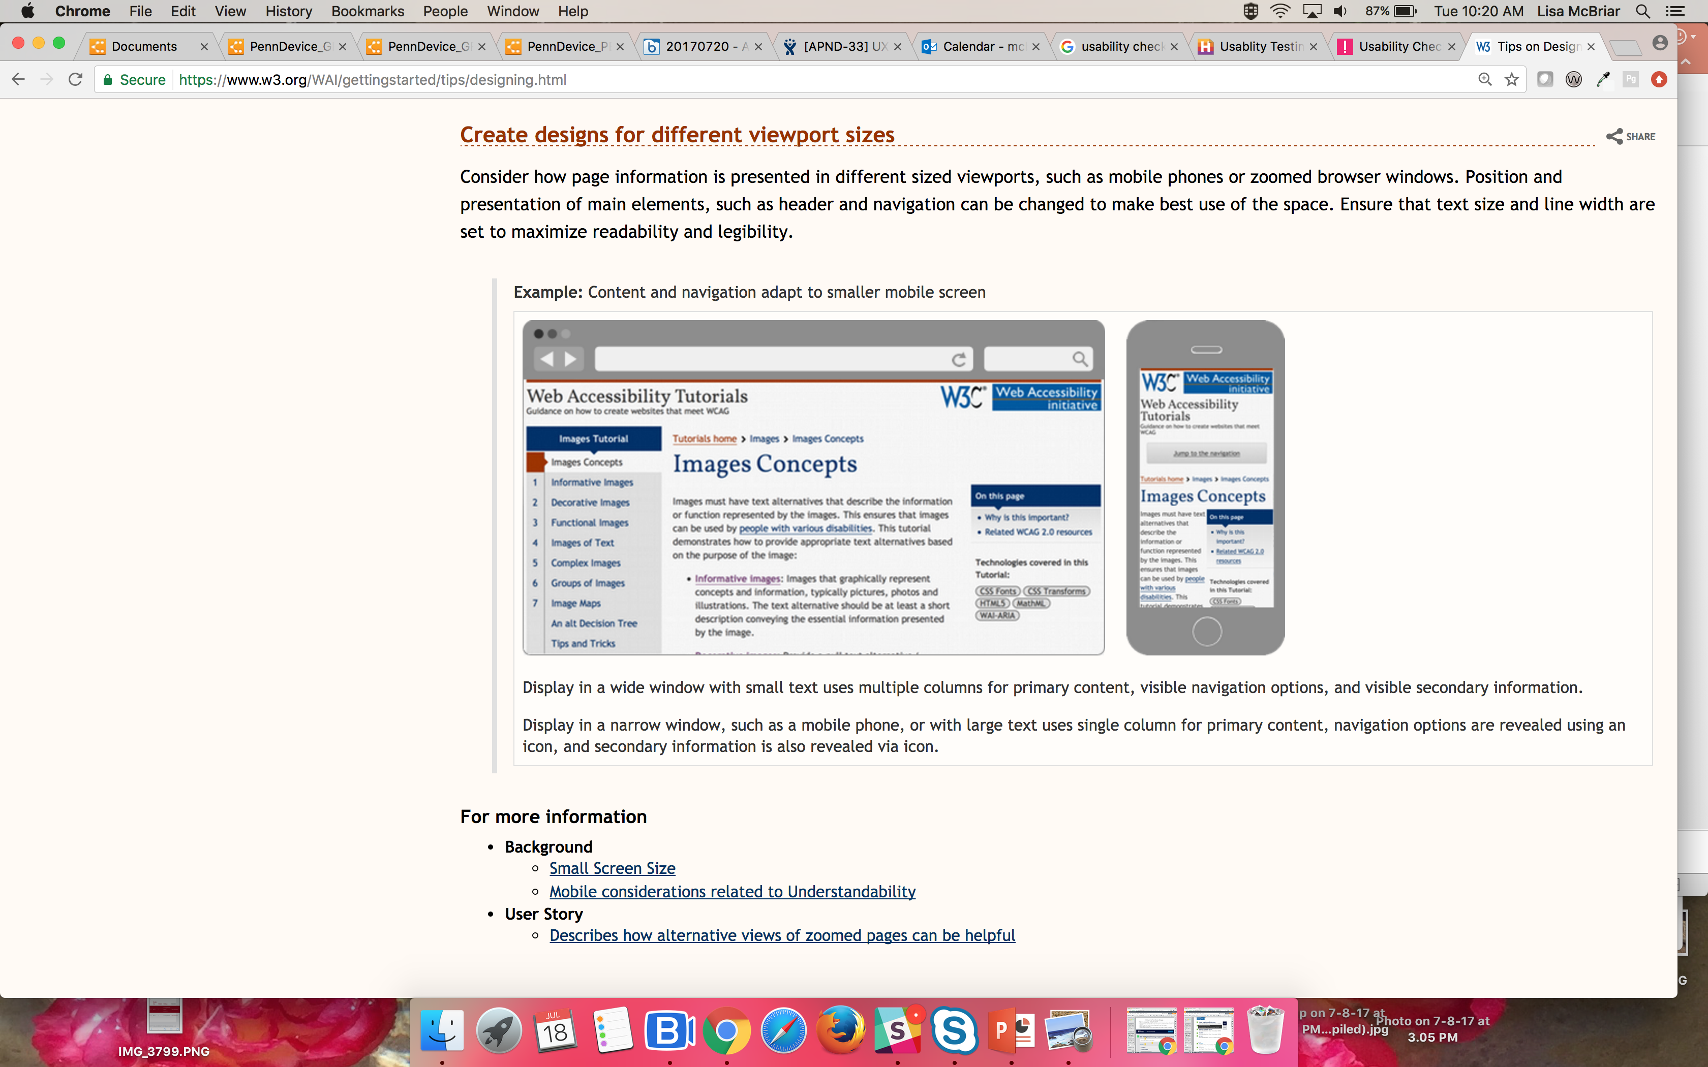
Responsiveness design principle example
https://www.w3.org/WAI/gettingstarted/tips/designing.html

Slide 41
UX Design
Why is UX design helpful?
Something to show clients QUICKLY
Something for clients to show their users
Something to easily change; frequently
How is our UX design process evolving?
Torchbox wireframes & components (VDI)
Torchbox wireframes & prototype app (GIVING)
Penn Mockups (VDI, GIVING, PennDevice)

Slide 42
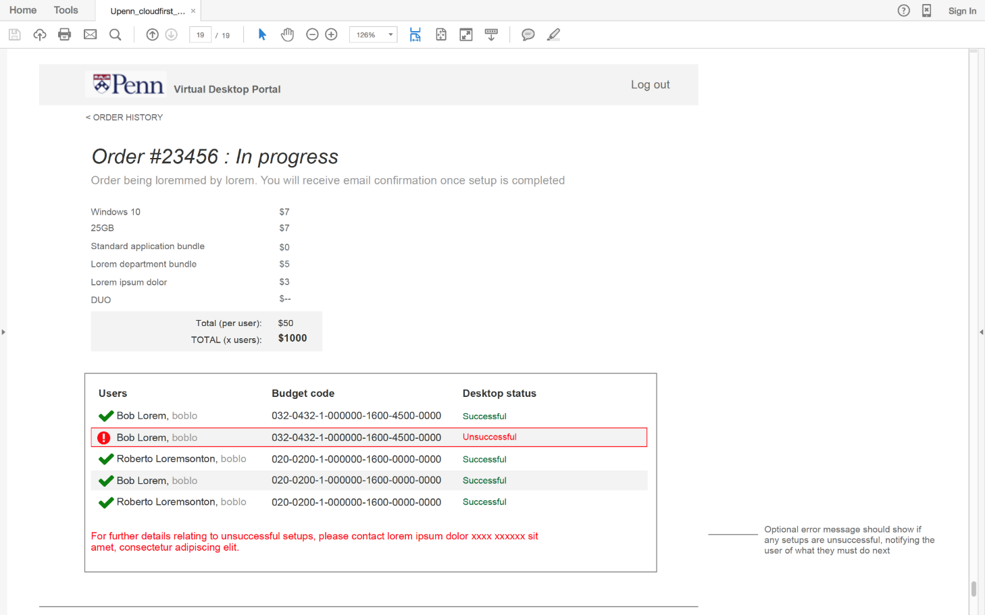
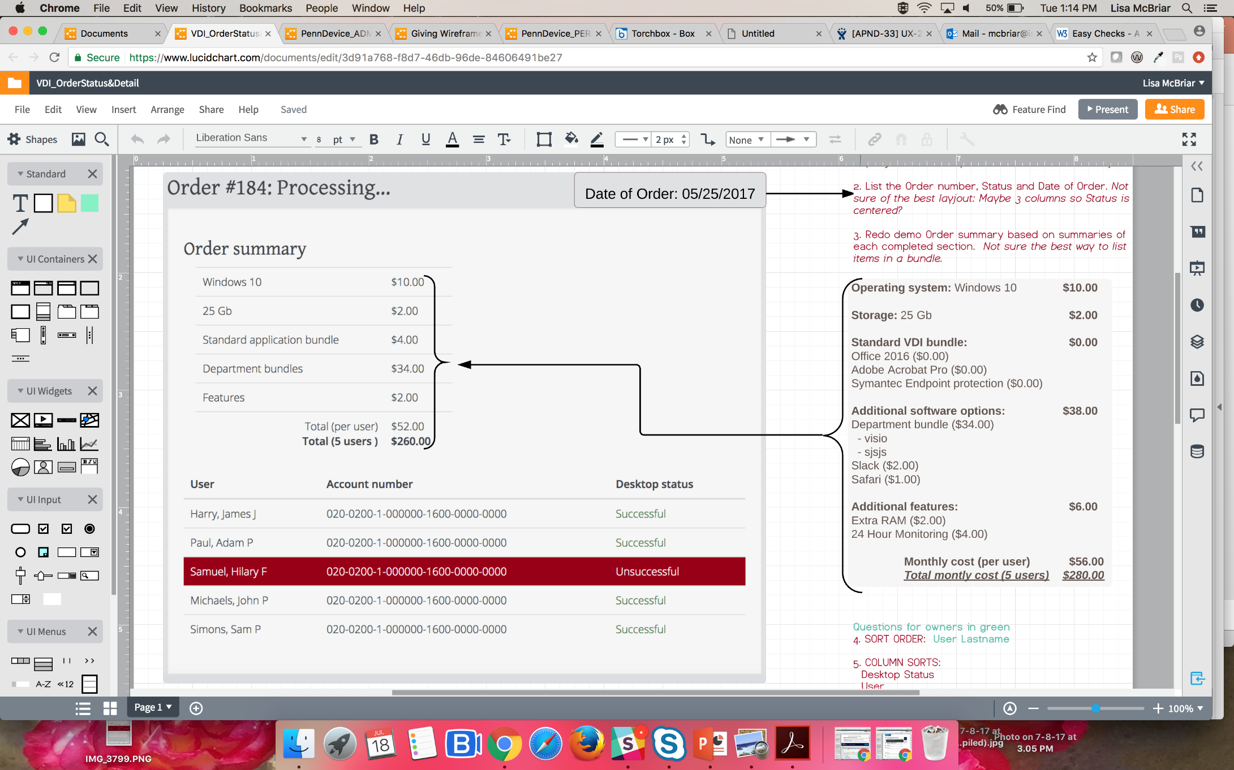
UX Desgin: Virtual Desktop (VDI)
Torchbox Wireframe
Penn Mockup (Lucidchart)
Screenshot from Torchbox component demo

Slide 43
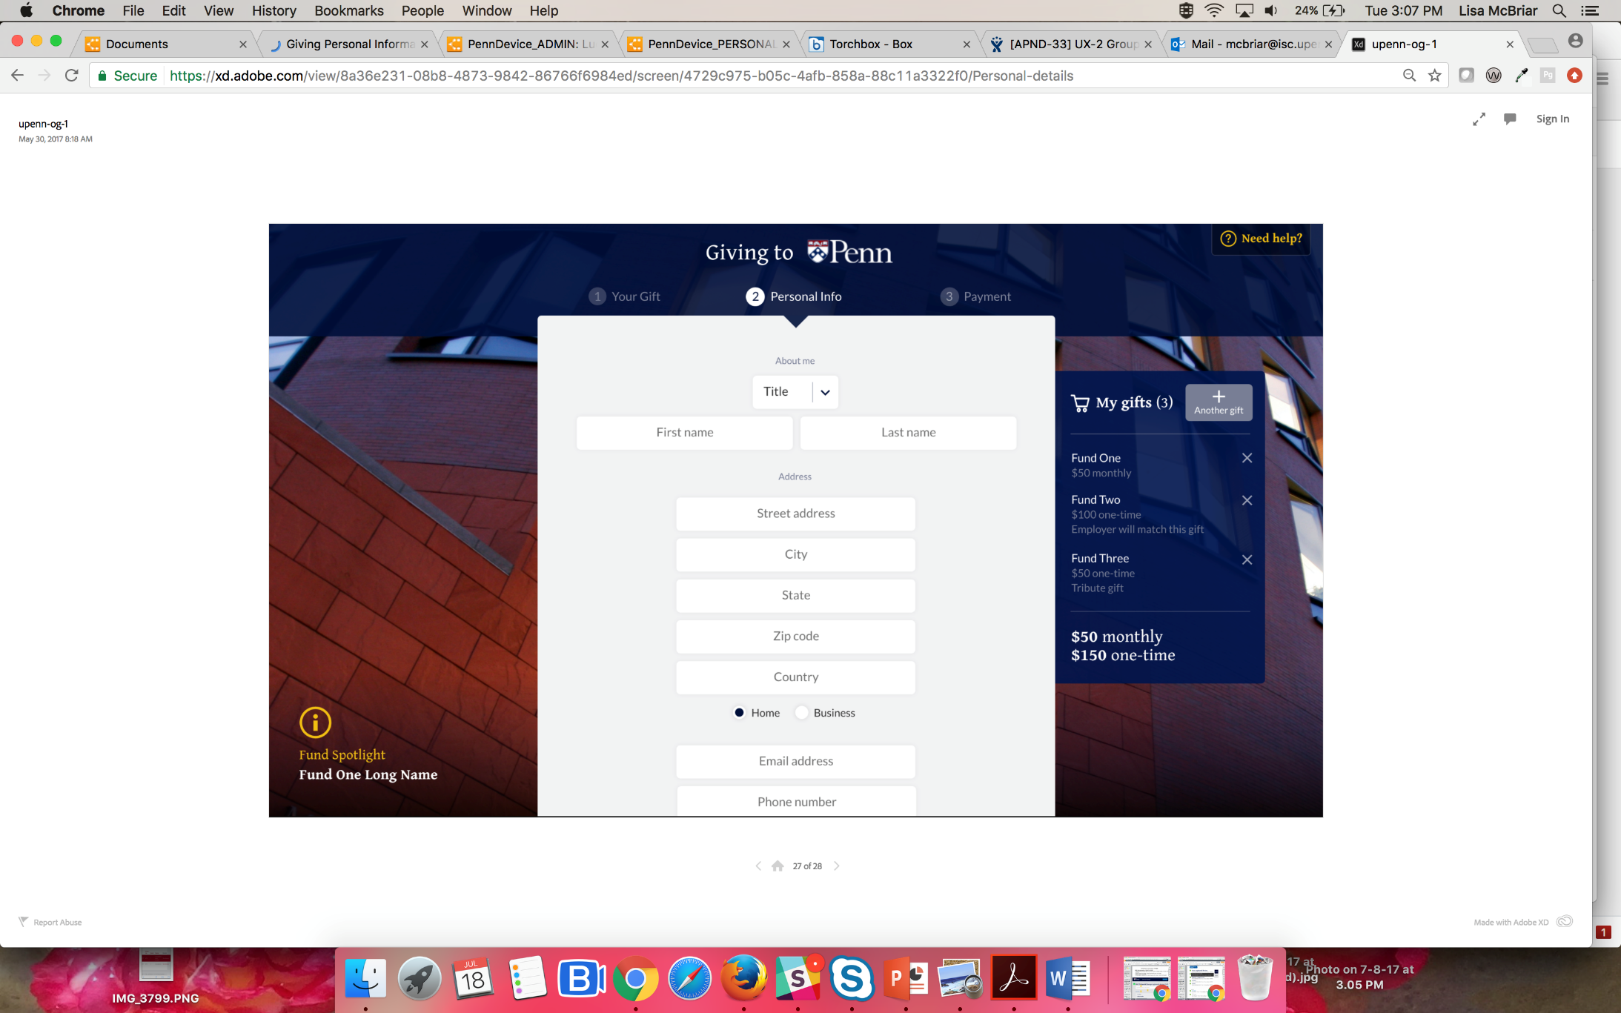
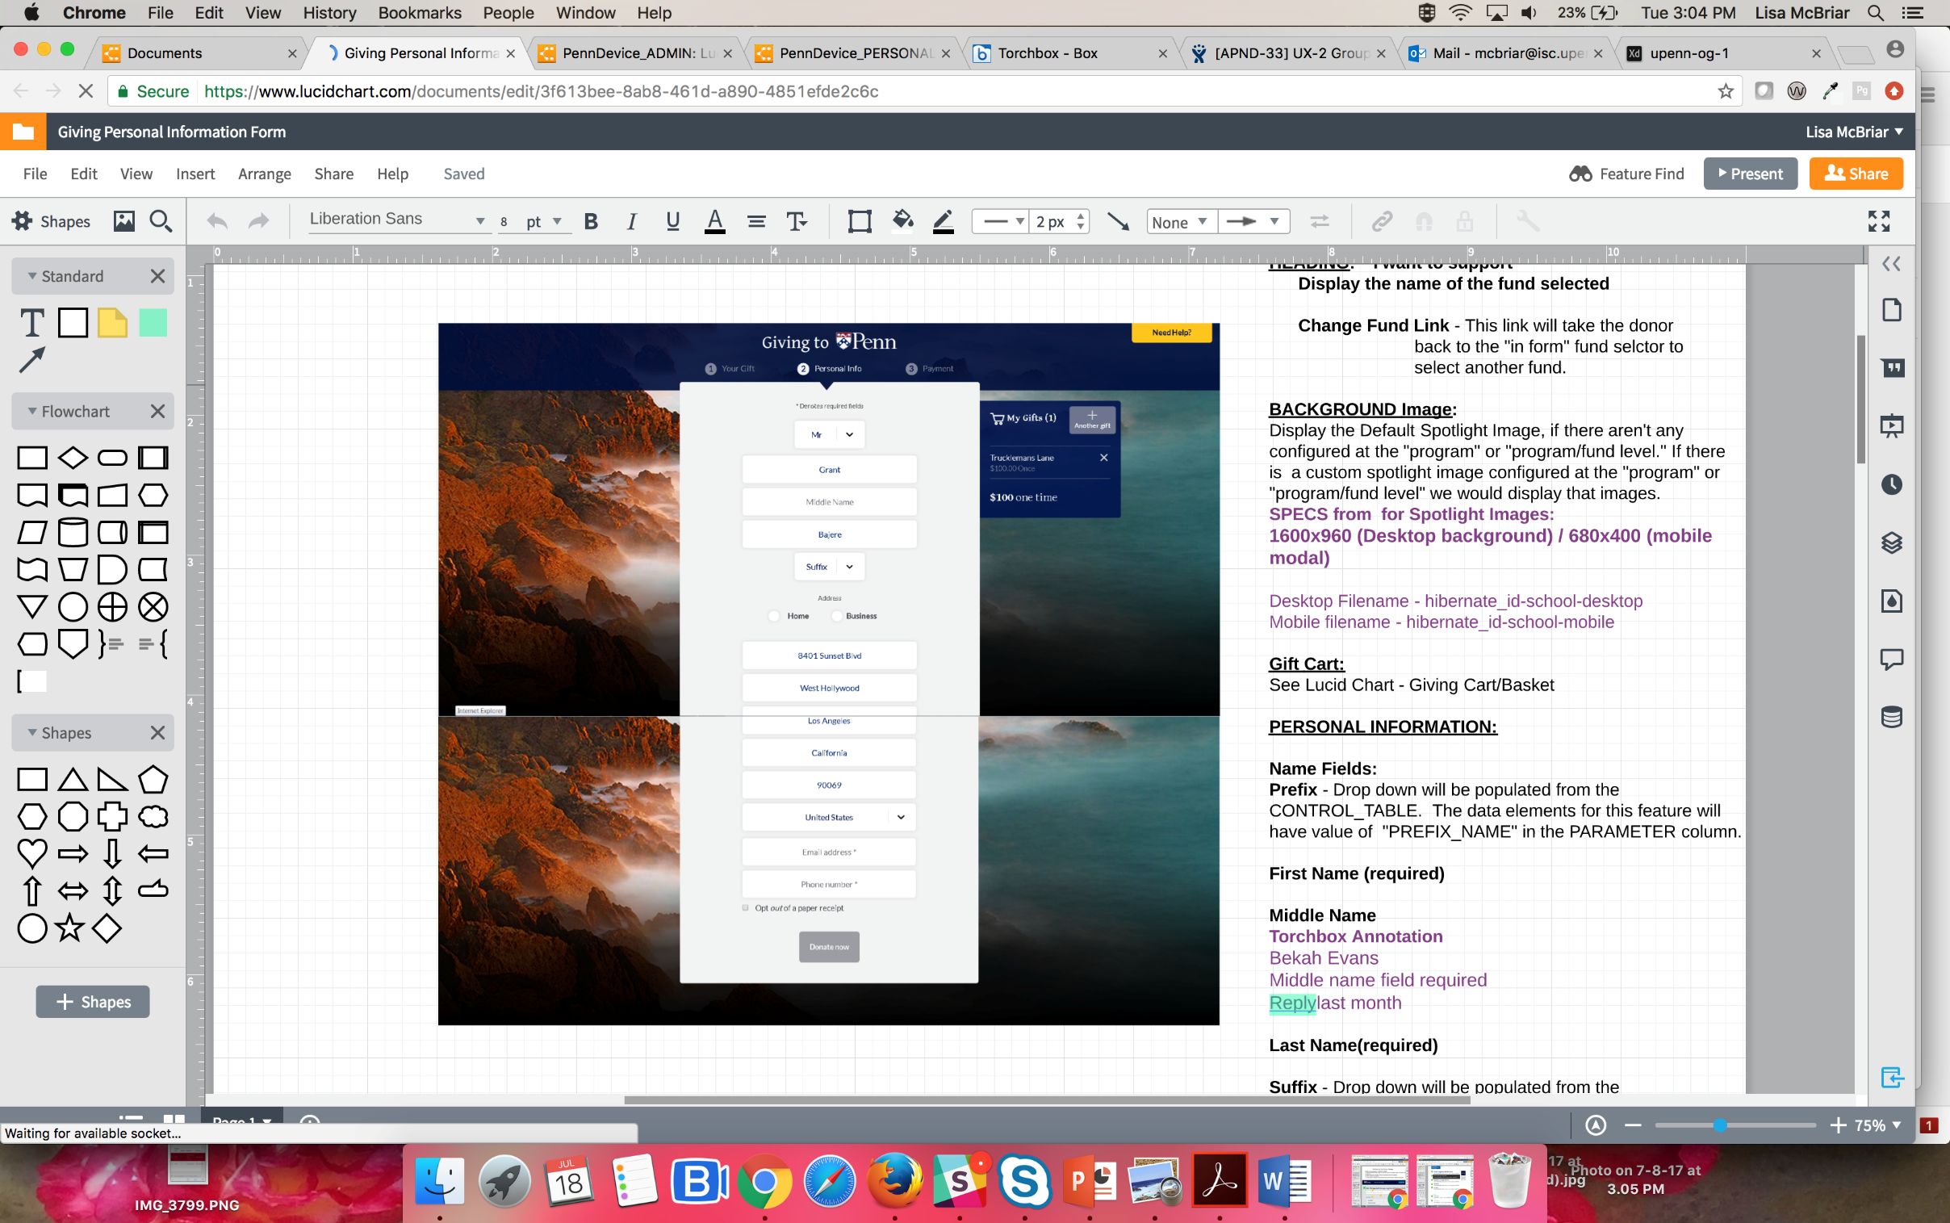
UX Design: GIVING
Torchbox Wireframe
Penn Mockup (Lucidchart)
Screenshot from Torchbox prototype app

Slide 44
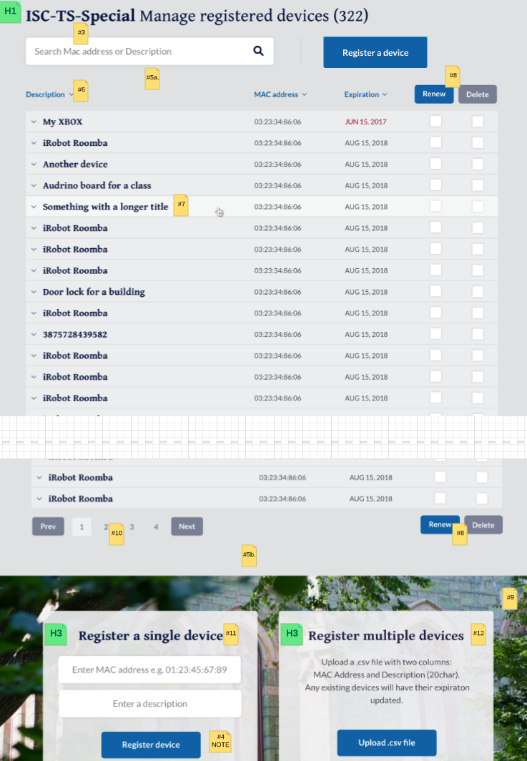
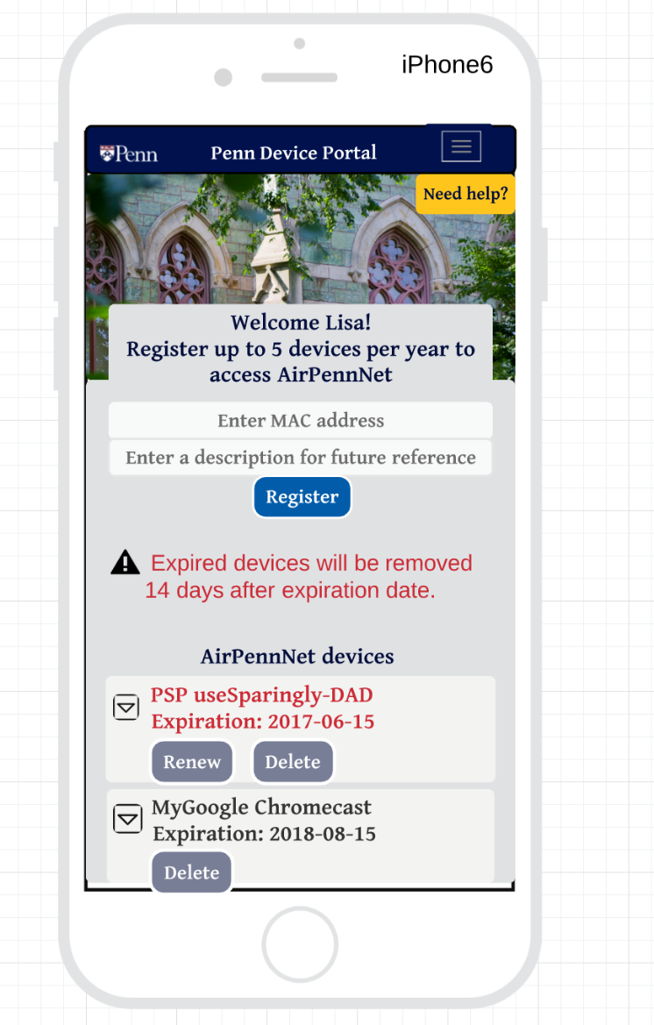
UX Design: Penn Device
Users: Students, Faculty, Staff
Call to actions
Lucidchart shape templates
Collaborative editing with clients
Client-User reviews (screenshots or pdfs)
Torchbox feedback
Styleguide
Easy integration w JIRA

Slide 45
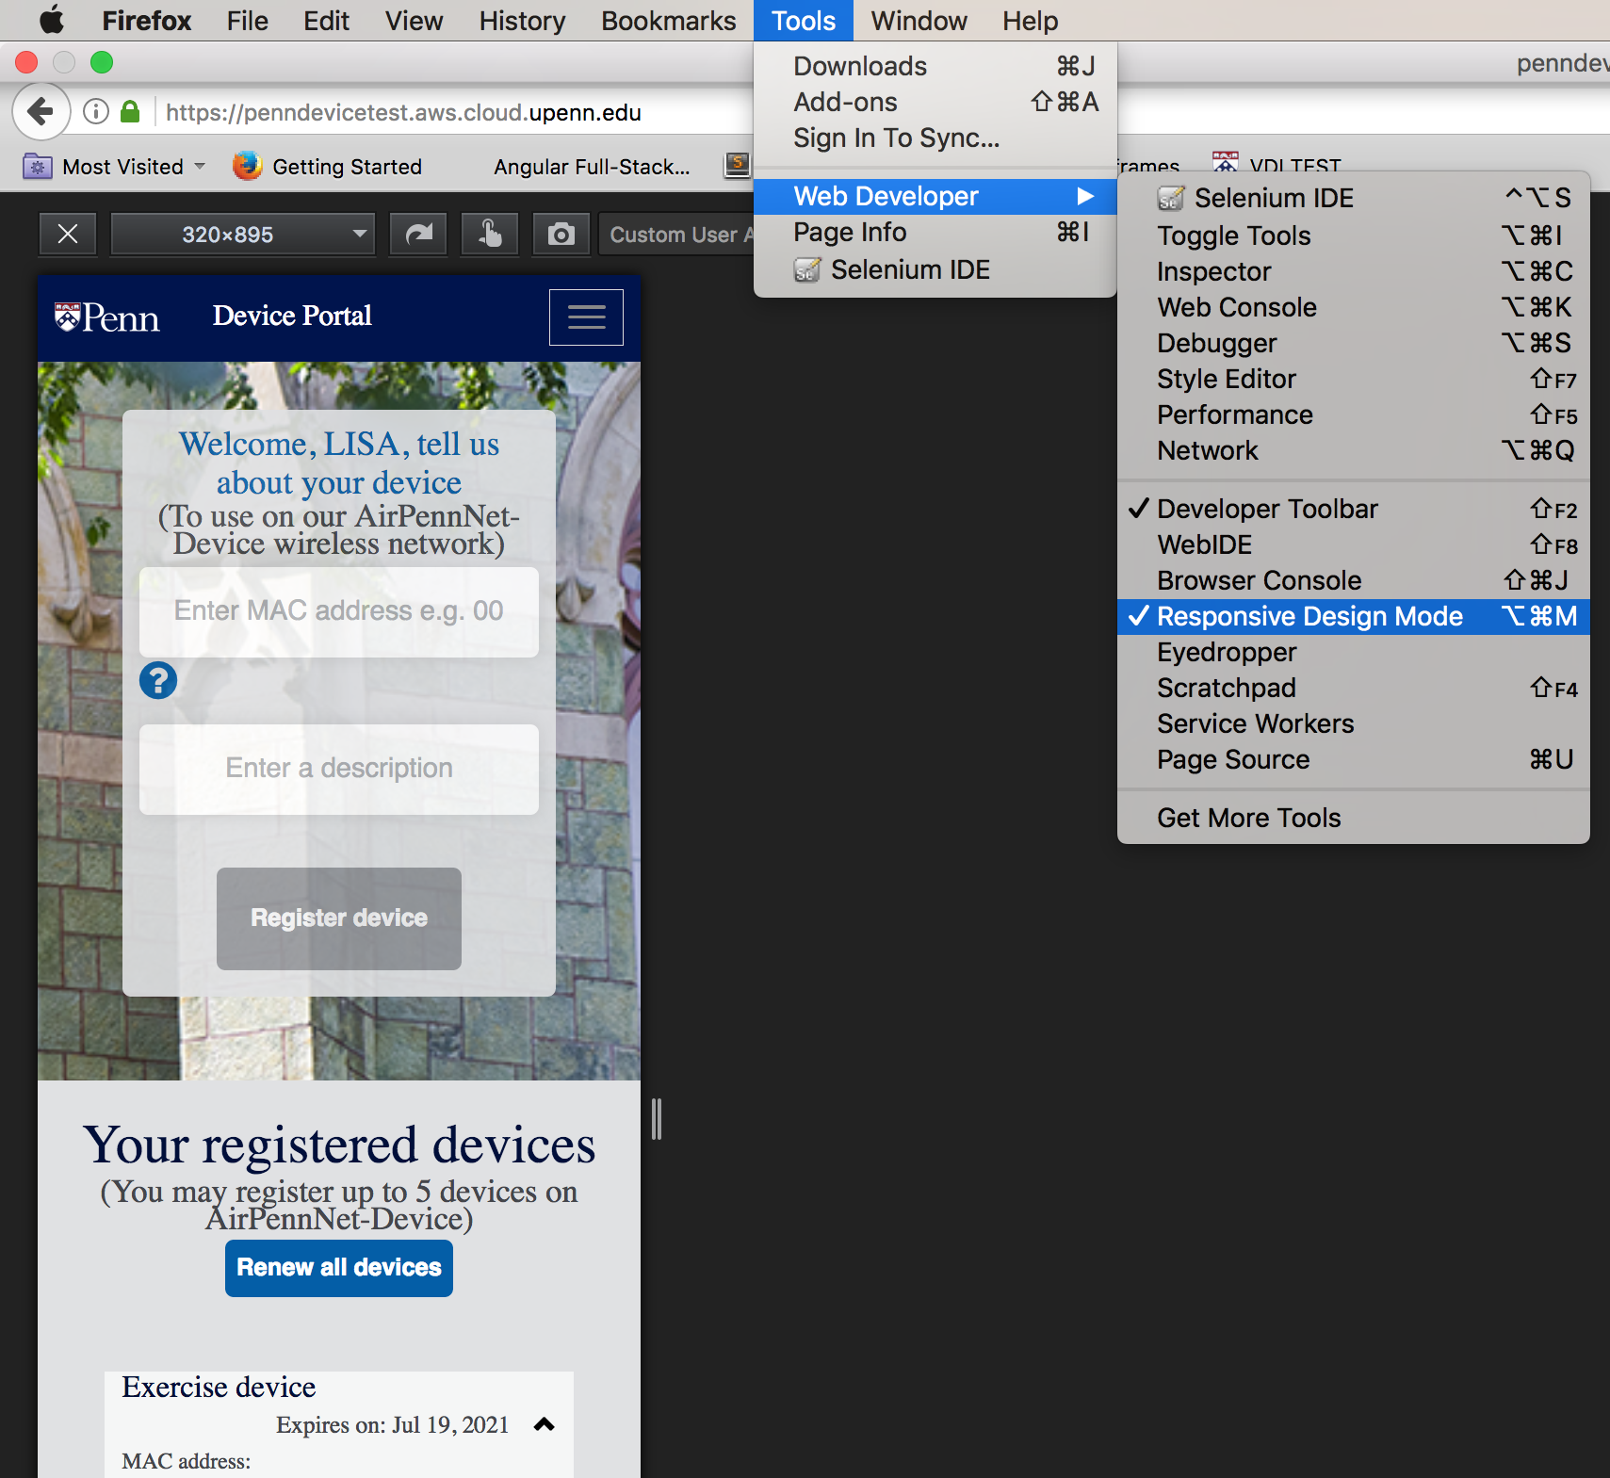
UX Design:
Responsiveness
Develop
Check page
Adjust design
Repeat…
Firefox >
Web Developer >
Responsive Design Mode

Slide 46
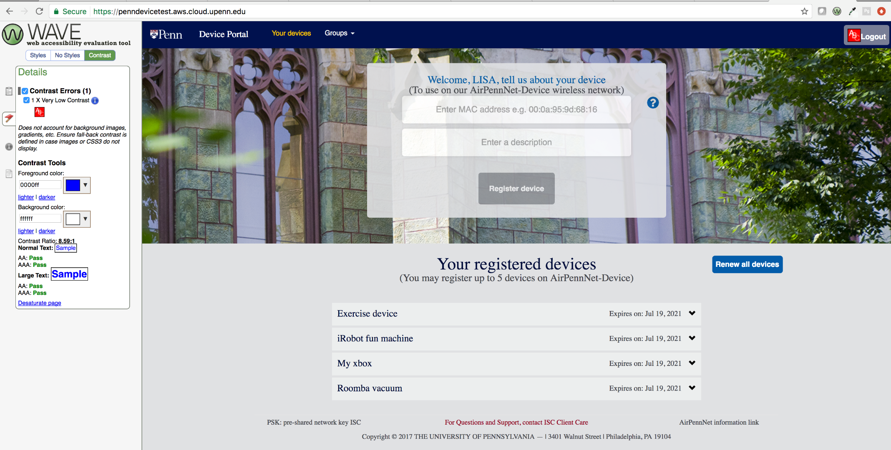
UX Design:
Accessibility
Develop
Check page
Adjust design
Repeat…
Chrome WAVE Plugin

Slide 47
Iterating with confidence:
Test Driven Development Demo

Slide 48
Putting it all Together

Slide 49
We are being judged…
Increasingly for our…
Speed!
Accessibility (usability for those with disabilities)
Responsiveness (usability on a wide range of devices)
Cost transparency
Less for our…
Risk profile
Meticulous custom services
Less is not none!
Notes:
Because there is still risk…

Slide 50
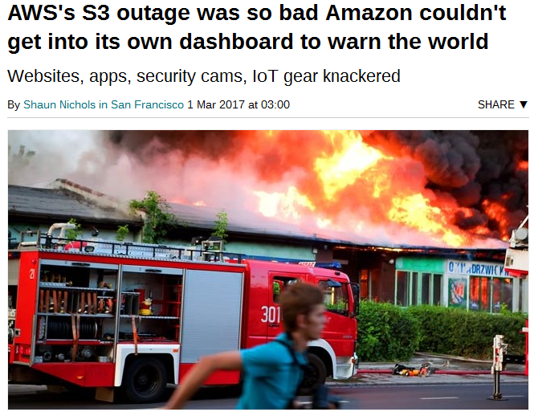
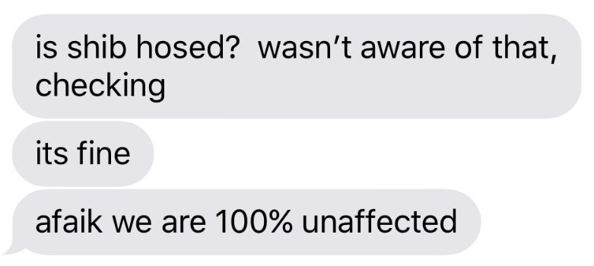
A shift in risk, not a magic bullet
AWS S3 Outage – 2/28/2017
Data Center Outages – 6/21,28/2017
Bad day for the cloud
Developers in the dark
Apps couldn’t restart
Images didn’t load
Good day for the cloud
Developers unaffected (but it was dark)
Apps ran and could be built (thanks to Shibboleth distribution)
Campus integrations degraded gracefully
Credit: Matt’s iPhone
Credit: The Register https://www.theregister.co.uk/2017/03/01/aws_s3_outage/
Notes:
Its just been shifted, not eliminated.
But we think the odds are on our side, and we can shift our focus to Penn challenges instead of technology challenges

Slide 51
Summarizing the Upside

Slide 52
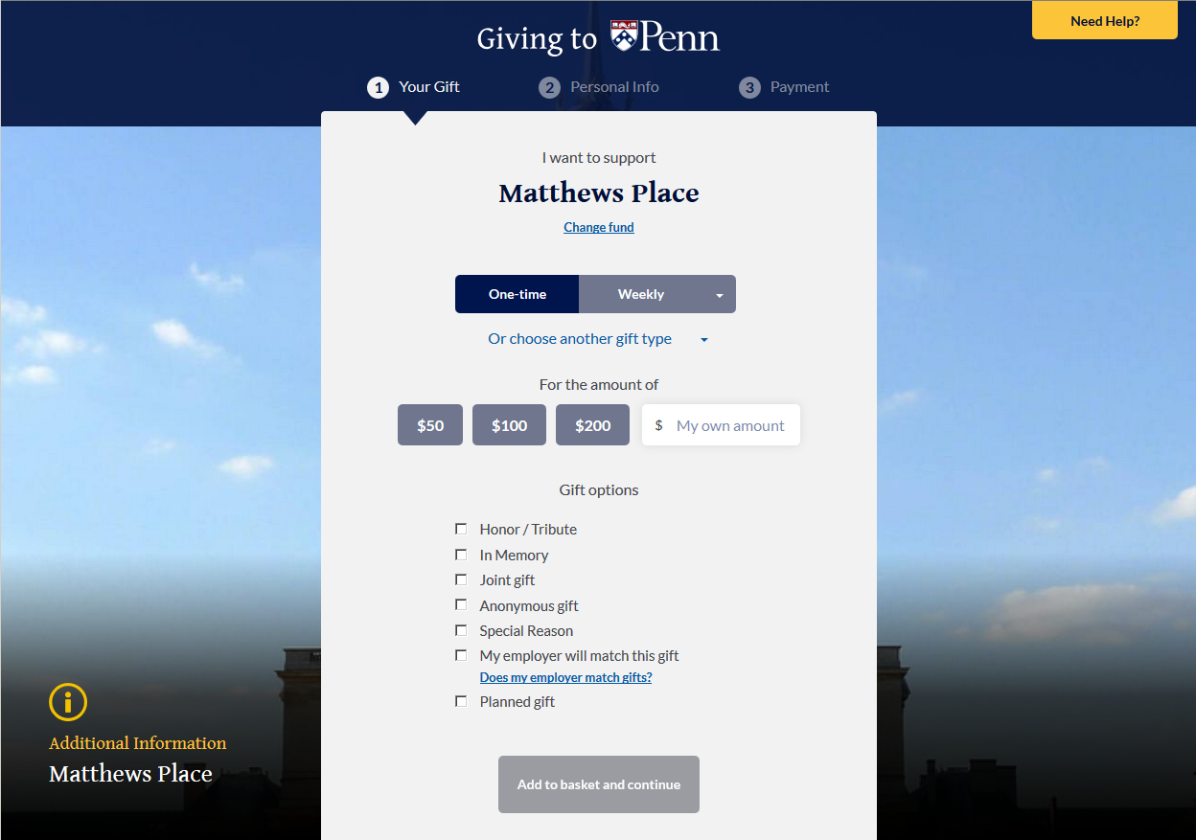
We want to let you build this
Consistent
Accessible
Responsive
Notes:
A wide open canvas using components provided by a sea of developers

Slide 53
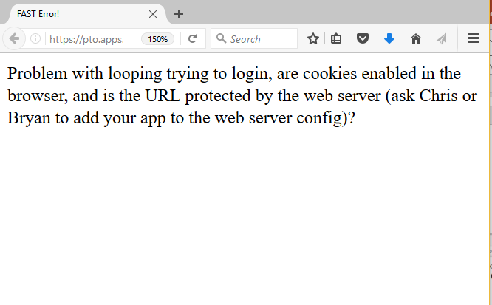
And never again see this:
Notes:
This error message embarrasses me because you don’t need me to do cool stuff. We just need to find ways to get out of the way in an orderly manner.

Slide 54

Because you should never feel like this:
Notes:
You shouldn’t feel like Oliver Twist waiting for small morsels

Slide 55

… you should feel like this!
Notes:
You should be unleased to cook your own feast

Slide 56
How to start?
Many already have, that’s great!
Think of it as learning to learn, not learning a framework or frameworks
Almost everything you’ve seen here is open source and free. Try it out!
Python / Django REST
PyCharm Community Edition
AngularJS
Bootstrap
NodeJS
PostgreSQL
Gitlab
https://www.isc.upenn.edu/cloud-developer-curriculum
Share and ask questions in #cloud-first on Slack
http://upenn-isc.slack.com
Join Dev-SIG on Slack (#dev-sig) and Gitlab
http://upenn-it.slack.com
https://gitlab.com/upenn-dev-sig
Notes:
Justin, Frank, Muthu, Melina, Yan…

Slide 57
What’s next…
Lowering the barrier of entry for API Services
Improving test automation
Improving build automation
Improving deployment automation
Improving agile processes
… and whatever’s on your mind. Thank you!
Notes:
This is what the top of our long backlog looks like
But what’s on your mind? Questions?

Slide 58
Special Thanks and Credits
James Choate
Justin Ettore
Katie Faucett
Dane Fetterman
Tiffany Hanulec
Teresa Leo
Janet Lind
John Mulhern III
Janice Panesar
Isobel Thompson
Namitha Venkatesh
Mathias Wegner

